Slide 1
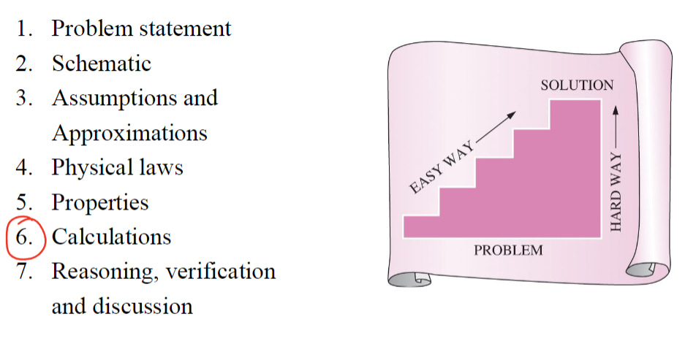
Course Info
Time: TR 8:00-9:15 AM
Location: CHEN 106
Teaching Assistants:
Reagan Kutter
Email: regankk@tamu.edu
Time: Friday 1:45-2:45 PM
Location: CHEN 540
Ashish Shyam Tangade
Email: ashish.tangade@tamu.edu
Time: Wednesday 4:00-5:00 PM
Location: CHEN 540
2-3 on Thursdays
Instructor: Jeetain Mittal
Office: CHEN 500
Phone: (979) 862-1920
Email: Jeetain@tamu.edu
Office Hours:
Monday 2:00-3:00 PM
By appointment
Grading Info
Category | Date | Percentage
Participation/Quizzes | N/A | 5%
Homework | N/A | 10%
Midterm 1 | Sep 24th | 25%
Midterm 2 | Nov 7th | 25%
Final | Dec 6th 1:00-3:00 | 35%

Slide 2
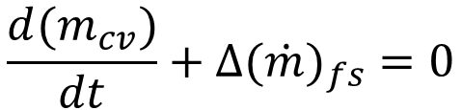
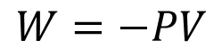
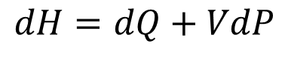
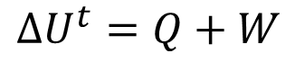
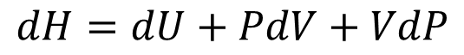
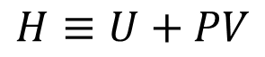
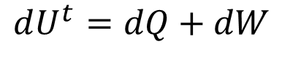
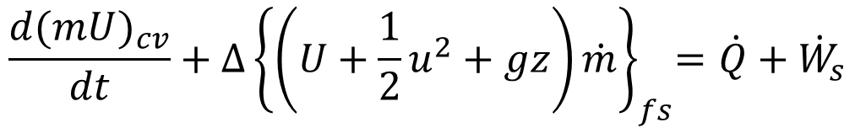
1st Law of Thermodynamics: Energy is conserved
Energy Balance on closed system
$$∆U^{t}=Q+W$$
$$W=−PV$$
$$dU^{t}=dQ+dW$$
Enthalpy
$$H≡U+PV$$
$$dH=dU+PdV+VdP$$
$$dH=dQ+VdP$$
Energy Balance on open system
$$\frac{d(m_{cv})}{dt}+∆(\dot{m})_{fs}=0$$
$$\frac{d(mU)_{cv}}{dt}+{∆\left\{\left(U+\frac{1}{2}u^{2}+gz\right)\dot{m}\right\}}_{fs}=\dot{Q}+{\dot{W}}_{s}$$

Slide 3
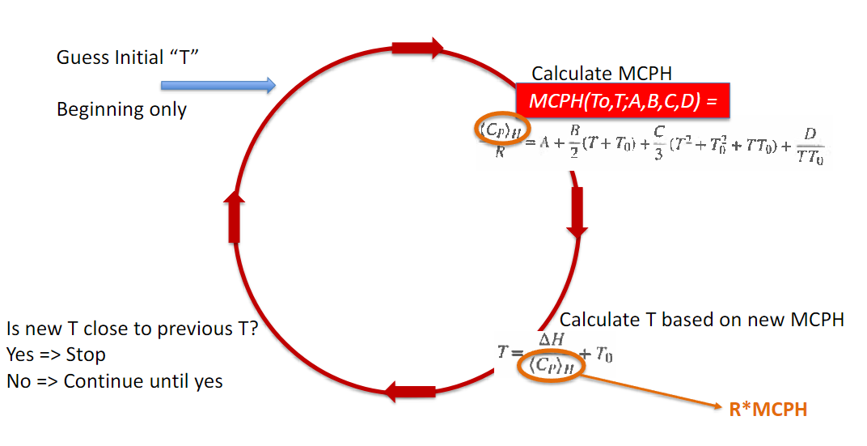
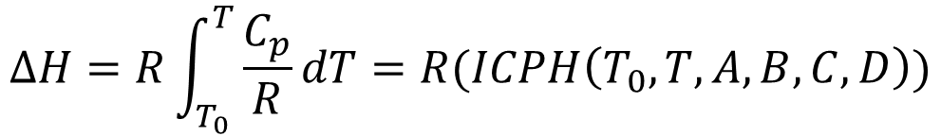
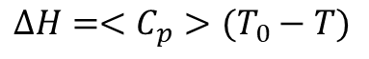
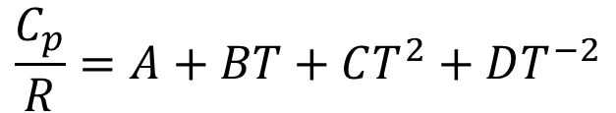
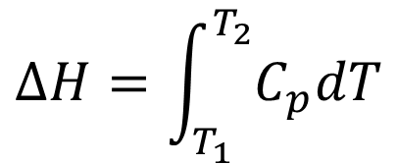
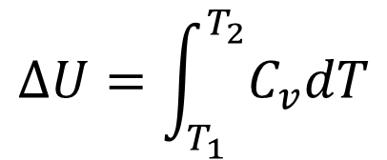
Constant Volume and constant Pressure heat capacity
$$∆U=\int_{T_{1}}^{T_{2}}{C_{v}dT}$$
$$∆H=\int_{T_{1}}^{T_{2}}{C_{p}dT}$$
Temperature Dependence on heat capacity
$$\frac{C_{p}}{R}=A+BT+CT^{2}+DT^{−2}$$
$$∆H=R\int_{T_{0}}^{T}{\frac{C_{p}}{R}dT}=R(ICPH\left(T_{0},T,A,B,C,D\right))$$
Finding Temperature through changes in enthalpy
$$ICPH\left(T_{0},T,A,B,C,D\right)=MCPH\left(T_{0},T,A,B,C,D\right)\left(T_{0}−T\right)=\frac{<C_{p}>}{R}(T_{0}−T)$$
$$∆H=<C_{p}>(T_{0}−T)$$

Slide 4
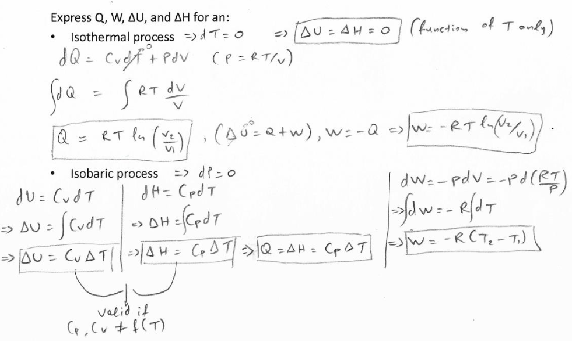
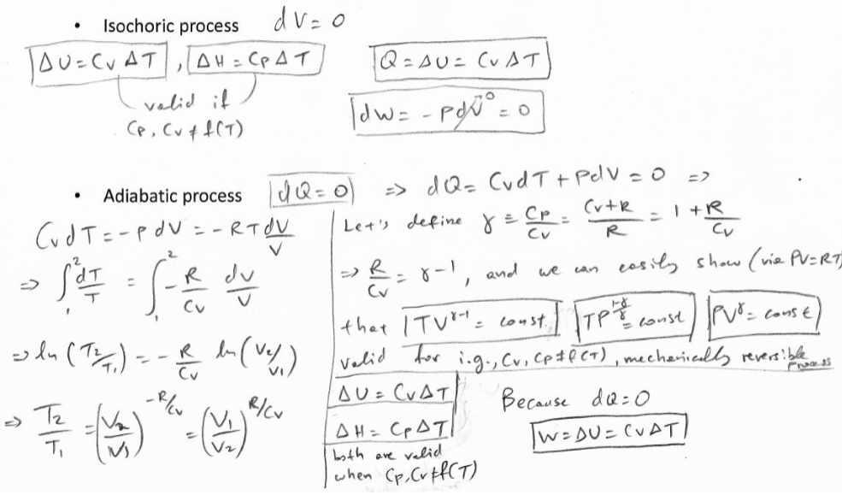
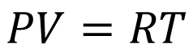
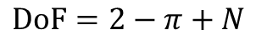
Equations of State
Gibbs’ Phase Rule
$$DoF=2−π+N$$
π = Number of phases, N = number of species
Ideal Gas Law
$$PV=RT$$
Finding Q, W, U, and H for reversible, closed systems

Slide 5
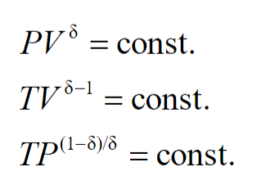
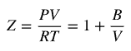
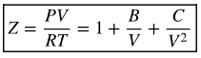
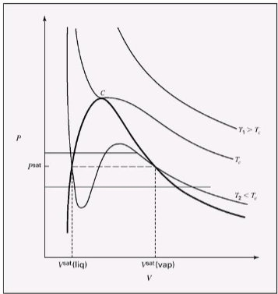
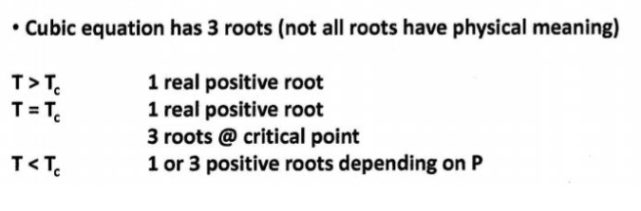
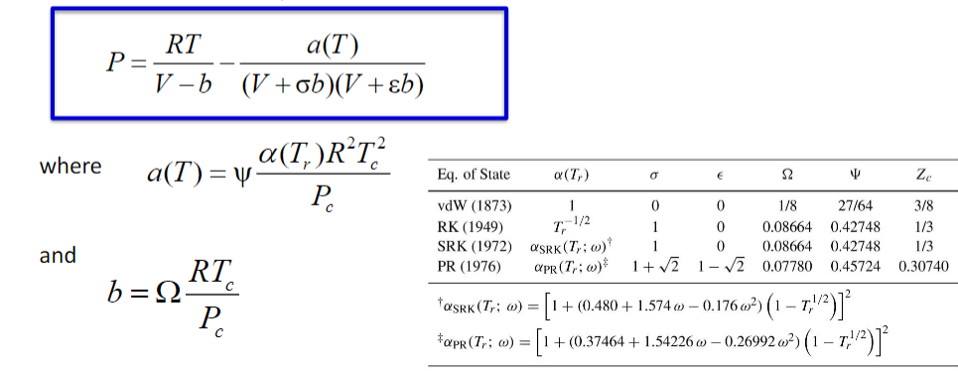
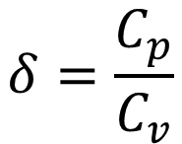
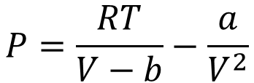
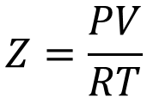
$$δ=\frac{C_{p}}{C_{v}}$$
Real Gasses
$$Z=\frac{PV}{RT}$$
Virial equation (2 and 3 term)
Cubic Equations of state
Van der Waals Equation of state
$$P=\frac{RT}{V−b}−\frac{a}{V^{2}}$$

Slide 6
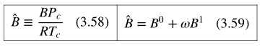
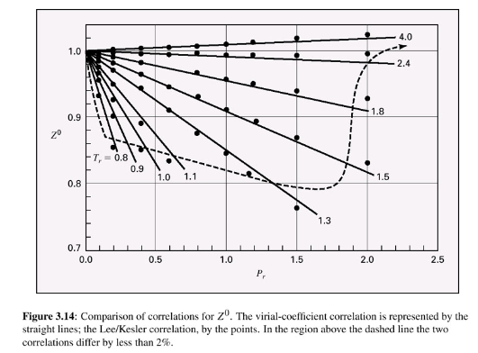
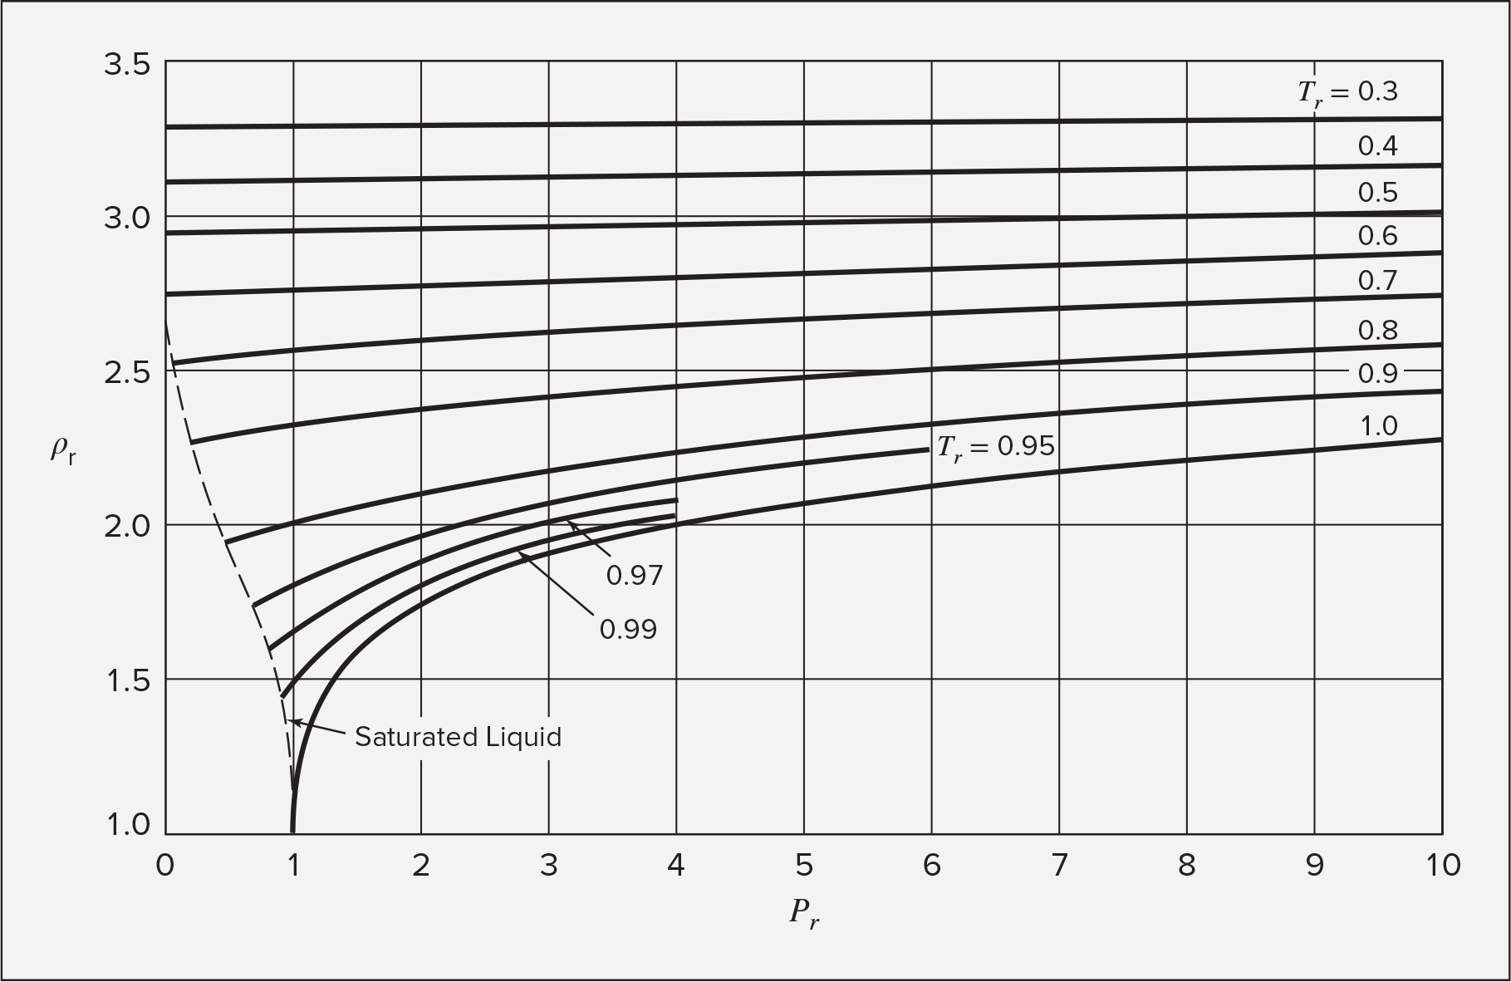
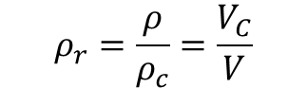
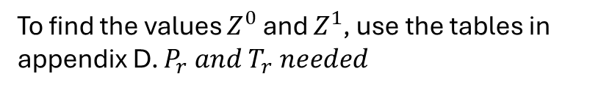
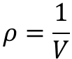
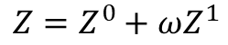
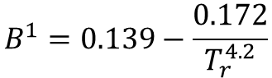
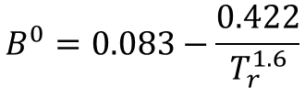
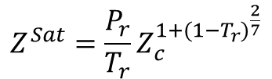
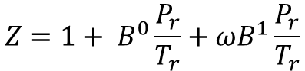
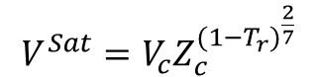
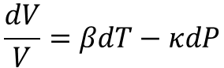
Pitzer Correlations
Compressibility Factor
Second virial coefficient
$$Z=Z^{0}+ωZ^{1}$$
To find the values $Z^{0}$ and $Z^{1}$, use the tables in appendix D. $P_{r} and T_{r} needed$
Note: Ideal gas law is acceptable to use if $Z^{0}$ is between 0.98 and 1.02 (2% error)
$$Z=1+ B^{0}\frac{P_{r}}{T_{r}}+ωB^{1}\frac{P_{r}}{T_{r}}$$
$$B^{0}=0.083−\frac{0.422}{T_{r}^{1.6}}$$
$$B^{1}=0.139−\frac{0.172}{T_{r}^{4.2}}$$
The Pitzer correlation for the second virial coefficient can only be used if inside the dotted line in on the figure
Changes in states for liquids based on isothermal compressibility and volume expansivity:
$$\frac{dV}{V}=βdT−κdP$$
Generalized correlations for liquids
Rackett equation
Two parameter corresponding states
Use density with the chart to get other info
$$V^{Sat}=V_{c}Z_{c}^{{(1−T_{r})}^{\frac{2}{7}}}$$
Good For saturated liquids
$$Z^{Sat}=\frac{P_{r}}{T_{r}}Z_{c}^{1+{(1−T_{r})}^{\frac{2}{7}}}$$
$$ρ=\frac{1}{V}$$
$$ρ_{r}=\frac{ρ}{ρ_{c}}=\frac{V_{C}}{V}$$

Slide 7
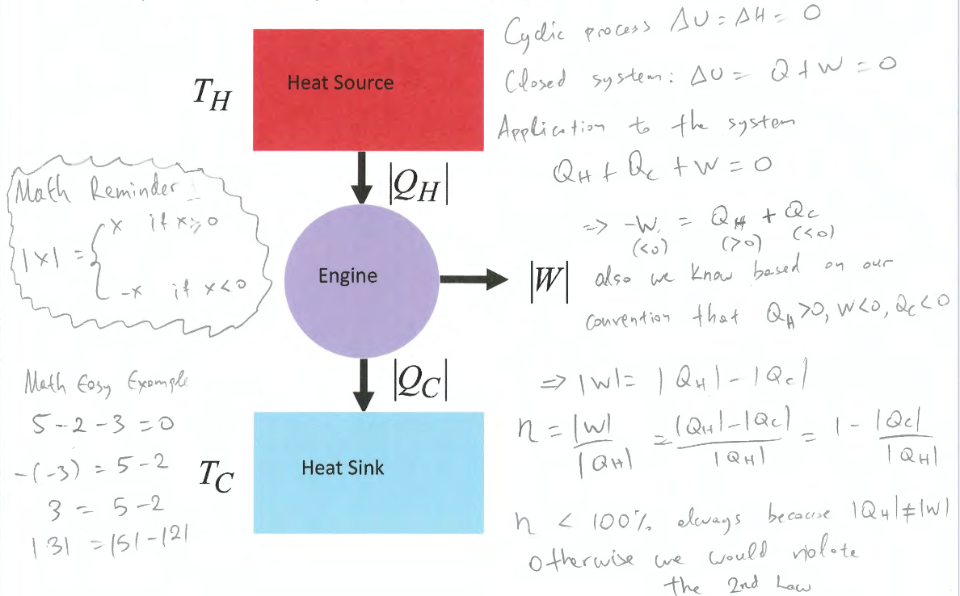
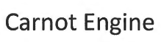
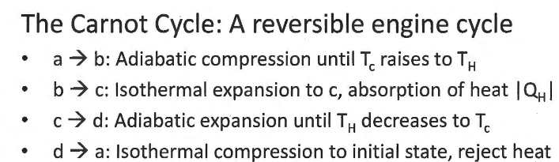
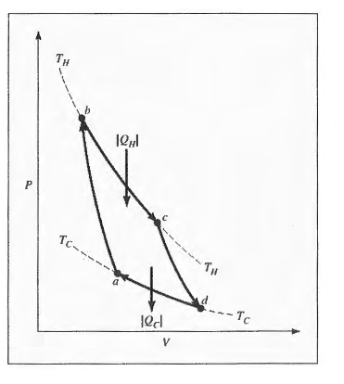
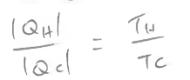
Entropy
2nd law: energy has different amounts of quality
EX: Work is more useful than heat

Slide 8
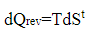
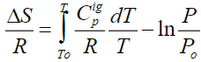
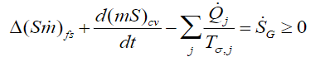
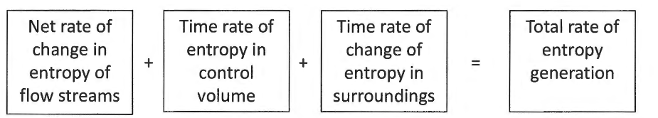




Changes in entropy of an ideal gas
Changes in entropy of an ideal gas in an open system
Chapter 6
Internal Energy
$$dU=TdS−PdV$$
Enthalpy
$$dH=TdS+VdP$$
Gibbs Free Energy
$$dG=VdP−SdT$$
Helmholtz Free Energy
$$dA=−PdV−SdT$$

Slide 9
























Maxwell’s Relations
Internal Energy
Enthalpy
$$dU=TdS−PdV$$
$$dH=TdS+VdP$$
$${\left.\frac{∂U}{∂S}\right|}_{V}=T$$
$${\left.\frac{∂U}{∂V}\right|}_{S}=−P$$
$${\left.\frac{∂H}{∂S}\right|}_{P}=T$$
$${\left.\frac{∂H}{∂P}\right|}_{S}=V$$
$${\left.\frac{∂T}{∂V}\right|}_{S}={\left.−\frac{∂P}{∂S}\right|}_{V}$$
$${\left.\frac{∂T}{∂P}\right|}_{S}={\left.\frac{∂V}{∂S}\right|}_{P}$$
Gibbs Free Energy
Helmholtz Free Energy
$$dG=VdP−SdT$$
$$dA=−PdV−SdT$$
$${\left.\frac{∂G}{∂P}\right|}_{T}=V$$
$${\left.\frac{∂G}{∂T}\right|}_{P}=−S$$
$${\left.\frac{∂A}{∂V}\right|}_{T}=−P$$
$${\left.\frac{∂A}{∂T}\right|}_{V}=−S$$
$${\left.\frac{∂V}{∂T}\right|}_{P}=−{\left.\frac{∂S}{∂P}\right|}_{T}$$
$${\left.−\frac{∂P}{∂T}\right|}_{V}=−{\left.\frac{∂S}{∂V}\right|}_{T}$$
Other Relations to keep in mind
$${\left.β=\frac{1}{V}\frac{∂V}{∂T}\right|}_{P}$$
$${\left.κ=−\frac{1}{V}\frac{∂V}{∂P}\right|}_{T}$$
$${\left.\frac{∂P}{∂T}\right|}_{V}{\left.\frac{∂V}{∂P}\right|}_{T}{\left.\frac{∂T}{∂V}\right|}_{P}=−1$$
$$\frac{β}{κ}{\left.=\frac{∂P}{∂T}\right|}_{V}$$
$${\left.\frac{∂H}{∂T}\right|}_{P}=C_{P}$$
$${\left.\frac{∂U}{∂T}\right|}_{V}=C_{V}$$
$$dS={\left.\frac{∂S}{∂T}\right|}_{V}dT+{\left.\frac{∂S}{∂V}\right|}_{T}dV$$
$$dS={\left.\frac{∂S}{∂T}\right|}_{P}dT+{\left.\frac{∂S}{∂P}\right|}_{T}dP$$

Slide 10











Residual Properties
$$M^{R}≡M−M^{i}$$
Residual = Actual - Ideal
Using Lee Kesler Tables
$$\frac{H^{R}}{RT_{c}}={\frac{H^{R}}{RT_{c}}}^{0}+ω{\frac{H^{R}}{RT_{c}}}^{1}$$
$$\frac{S^{R}}{R}={\frac{S^{R}}{R}}^{0}+ω{\frac{S^{R}}{R}}^{1}$$
Values can be found in appendix D
Using second virial generalized correlation
Note: this method can only be used if you are inside the line on the figure below
$$\frac{H^{R}}{RT_{C}}=P_{r}\left[B^{0}−T_{r}\frac{dB^{0}}{dT_{r}}+ω\left(B^{1}−T_{r}\frac{dB^{1}}{dT_{r}}\right)\right]$$
$$\frac{S^{R}}{RT_{C}}=P_{r}\left[\frac{dB^{0}}{dT_{r}}+ω\frac{dB^{1}}{dT_{r}}\right]$$
$$B^{0}=0.083−\frac{0.422}{T_{r}^{1.6}}$$
$$B^{1}=0.139−\frac{0.172}{T_{r}^{4.2}}$$
$$\frac{dB^{0}}{dT_{r}}=\frac{0.675}{T_{r}^{2.6}}$$
$$\frac{dB^{1}}{dT_{r}}=\frac{0.722}{T_{r}^{5.2}}$$

Slide 11








Introduction
Equilibrium
State of balance, no unbalanced driving forces
Thermal EQ: Uniform temperature
Mechanical EQ: Uniform pressure to no tendency for pressure to change locally
Phase EQ: Mass of each phase stays in the same quantity
Chemical EQ: No tendency for changes in chemical composition
Thermodynamic EQ: Equilibrium with respect to all possible changes in state
To be at equilibrium, the system must be
isolated (No exchange of energy, mass or
volume). Entropy must also be at a maximum.
Internal energy will be at a minimum
Process: any change that a system undergoes
from one state to another
Path: The series of states a system
goes through during the process
To fully describe a process, one must know the
initial and final states, as well as the path taken
New way to define internal energy:
$$dS^{t}=\frac{δQ_{rev}}{T}$$
$$dU^{t}=δQ+δW$$
$δ$ <- inexact differential
(used for path functions)
$$dU^{t}=TdS^{t}−PdV^{t}$$
From Themo I
New Term associated with chemical potential
$$dU^{t}=TdS^{t}−PdV^{t}+μdn$$
$$d(nU)=Td(nS)−Pd(nV)+μdn$$
If n=1
$$dU=TdS−PdV+μdn$$
The fundamental equation

Slide 12

















$${\left.\frac{∂U}{∂S}\right|}_{V, n}=T$$
$${\left.\frac{∂U}{∂V}\right|}_{S,n}=−P$$
$${\left.\frac{∂U}{∂n}\right|}_{S,V}=μ$$
$$dU={\left.\frac{∂U}{∂S}\right|}_{V, n}dS+{\left.\frac{∂U}{∂V}\right|}_{S,n}dV+{\left.\frac{∂U}{∂n}\right|}_{S,V}dn$$
U(S, V, n)
Expressing thermodynamic properties in terms of different variables
Internal Energy
Enthalpy
$$U\left(S, V, n\right)$$
$$H\left(S, P, n\right)=U+PV$$
$$dU=TdS−PdV+μdn$$
$$dH=TdS+VdP+μdn$$
Entropy
$$S(U,V,n)$$
$$dS=\frac{1}{T}dU+\frac{P}{T}dV−\frac{μ}{T}dn$$
Helmholtz Free Energy
Gibbs Free Energy
$$A\left(T, V, n\right)=U−TS$$
$$G\left(T, P, n\right)=U−TS+PV=H−TS$$
$$dA=−SdT−PdV+μdn$$
$$dG=−SdT+VdP+μdn$$
Helmholtz and Gibbs are the most useful, because they are expressed in easily found values
All the energies are at a minimum at equilibrium, and entropy is at a maximum
$$d(nG)=−(nS)dT+(nV)dP+\sum_{i}{μ_{i}dn_{i}}$$
Why didn’t we need the chemical equilibrium term before now?
Before this we were dealing with single phase closed PVT systems, so $\sum_{i}{μ_{i}dn_{i}}=0$
For a system in which there are two phases and N number of species, $\sum_{i}{μ_{i}dn_{i}}=0$ can be applied separately to each phase
Combining them,

Slide 13



This means that
Since the changes in one phase are equal but opposite to the other phase
The differentials are independent and arbitrary, so the only way this equation is satisfied is if:
= 0
So, at equilibrium, the chemical potential for each phase of a species is equal
Flow chart when selecting how to find Thermodynamic properties
Gases
Liquids
Ideal Gas Law
Two term Virial
Cubic Equation of State
Lee Kesler Tables
Incompressible Liquid
Constant Beta and Kappa Values
Rackett Equations
Generalized Density correlation
Increasing Accuracy

Slide 14









Chapter 10: Solution Thermodynamics
10 is composed of a bunch of math, while 11 is applying it. Here we are combining them to hopefully make it easier
Mass/mole fractions
Molar concentration
How do we use pure component properties to predict mixture properties?
You can’t simply get properties of mixtures by adding the pure property components together
Intensive form for the difference between the actual volume and predicted volume
$$∆V_{mix}=V_{mix}−(x_{1}V_{1}+x_{2}V_{2})$$
$∆V_{mix}=0$: ideal solution, $∆V_{mix}<0$: contraction, $∆V_{mix}>0$: expansion
In general,
$$∆M_{mix}=M−\sum_{i}{x_{i}M_{i}}$$
Where M is V, S, U, H, A, or G
If we define $∆M_{mix}$ as $M^{E}$ and $\sum_{i}{x_{i}M_{i}}$ as $M^{id}$, we get
$$M^{E}=M−M^{id}$$
$M^{E}$is the excess property
For entropy we need to add another term
This is because adding 2 of the same species together will increase the entropy
This applies to functions with entropy as well,
$$S^{E}=S−\sum_{i}{x_{i}S_{i}}+R\sum_{i}{x_{i}\ln{x_{i}}}$$
$$G^{E}=G−\sum_{i}{x_{i}G_{i}}−RT\sum_{i}{x_{i}\ln{x_{i}}}$$

Slide 15









Mathematical framework for solving for solutions
Partial Properties: Represent the actual change from the expected property when in a mixture
Quantities of other substances
How the actual property changes with respect to the amount of it in the mixture with everything else held constant
These can be hard to represent, because The relationship can change in different ways depending on other factors.
Representing a change in a property based on the changes of its dependent variables (using a two-substance mixture for simplicity)
$$d\left(nM\right)={\left.\frac{∂(nM)}{∂T}\right|}_{P, n_{1},n_{2}}dT+{\left.\frac{∂(nM)}{∂P}\right|}_{T, n_{1},n_{2}}dP+{\left.\frac{∂(nM)}{∂n_{1}}\right|}_{T,P,n_{2}}dn_{1}+{\left.\frac{∂(nM)}{dn_{2}}\right|}_{T,P, n_{1}}dn_{2}$$
Can be represented as partials
$$d\left(nM\right)=ndM+Mdn$$
$$dn_{2}=d\left(nx_{2}\right)=ndx_{2}+x_{2}dn$$
$$dn_{1}=d\left(nx_{1}\right)=ndx_{1}+x_{1}dn$$
Combining all these equations ans inserting partials…
$$ndM+Mdn={\left.\frac{∂(nM)}{∂T}\right|}_{P, n_{1},n_{2}}dT+{\left.\frac{∂(nM)}{∂P}\right|}_{T, n_{1},n_{2}}dP+n\overline{M_{1}}dx_{1}+x_{1}\overline{M_{1}}dn+n\overline{M_{2}}dx_{2}+x_{2}\overline{M_{2}}dn$$
Consolidating terms into $n$ and $dn$ camps
$$\left[dM−{\left.\frac{∂M}{∂T}\right|}_{P, n_{1},n_{2}}dT−{\left.\frac{∂M}{∂P}\right|}_{T, n_{1},n_{2}}dP−\overline{M_{1}}dx_{1}−\overline{M_{2}}dx_{2}\right]n+\left[M−x_{1}\overline{M_{1}}−x_{2}\overline{M_{2}}\right]dn=0$$
Since $n$ and $dn$ don’t rely on each other…
$$M=x_{1}\overline{M_{1}}+x_{2}\overline{M_{2}}$$
$$M=\sum_{i}{x_{i}{\overline{M}}_{i}}$$
Summability

Slide 16















Also, from the consolidated function:
$$dM={\left.\frac{∂M}{∂T}\right|}_{P, n_{1},n_{2}}dT+{\left.\frac{∂M}{∂P}\right|}_{T, n_{1},n_{2}}dP+\overline{M_{1}}dx_{1}+\overline{M_{2}}dx_{2}$$
By taking the derivative of
$$M=x_{1}\overline{M_{1}}+x_{2}\overline{M_{2}}$$
$$dM={\overline{M}}_{1}dx_{1}+x_{1}d{\overline{M}}_{1}+{\overline{M}}_{2}dx_{2}+x_{2}d{\overline{M}}_{2}$$
By setting them equal
$$x_{1}d{\overline{M}}_{1}+x_{2}d{\overline{M}}_{2}={\left.\frac{∂M}{∂T}\right|}_{P, n_{1},n_{2}}dT+{\left.\frac{∂M}{∂P}\right|}_{T, n_{1},n_{2}}dP$$
Gibbs-Duhem Equation for a mixture
If T and P are constant…
You can use this as a consistency check for set of partial molar equations
$x_{1}d{\overline{M}}_{1}+x_{2}d{\overline{M}}_{2}=$0
$$\sum_{i}{x_{i}d{\overline{M}}_{i}}=0$$
This shows that partial molar properties don’t vary independently. Analogous to the constraint on mole fractions, where changes in one cause changes in another, because they can’t all sum to one. Similarly, the mole-fraction weighted sum of the partial properties must yield the overall solution property, and this constrains variation in partial molar properties with composition.
Partial properties are inherently arbitrary, because they assign part of a mixture to one species, even though in the mixture the species are intermingled. Though, since how partial properties are defined make them have all the characteristics as the individual species, this is ok
Getting ${\overline{M}}_{i}$
$$M=x_{1}\overline{M_{1}}+x_{2}\overline{M_{2}}$$
$x_{1}d{\overline{M}}_{1}+x_{2}d{\overline{M}}_{2}=$0
$$dM={\overline{M}}_{1}dx_{1}+{\overline{M}}_{2}dx_{2}$$
$$x_{1}+x_{2}=1$$
$$dx_{1}=−dx_{x}$$
Additionally, these equations, which are derivatives of the Gibbs-Duhem equation can be found
$$dM=\left({\overline{M}}_{1}−{\overline{M}}_{2}\right)dx_{1}$$
$$\frac{dM}{dx_{1}}={\overline{M}}_{1}−{\overline{M}}_{2}$$

Slide 17




Some representations of how to find ${\overline{M}}_{i}$ given a graph.
Where the slope intercepts the boundaries on each side are the values for the partials
The pure species property Mi and the Partial Mi in infinitesimally small fractions can be found by graphing M and finding where the slope intercepts 0 and 1 on the x1 axis at that specific value of x1

Slide 18









Relations among partial Properties
We can use Maxwell’s relations to create some connections
Just like we did in chapter 6 by selecting T and P, we can select T or P and n
This gives us relations of partial Gibbs free energy and other partial properties
And for Gibbs free energy with changes of T and P…
Ideal Gas Mixture model
Equals 1, because you are holding other mole quantities constant, so changes in the total moles equal changes in the wanted moles
Partial Pressure
For Simplicity, when dealing with fractions, x is used with liquids and y is used with gases

Slide 19










Gibbs Theorem
So, for internal energy and enthalpy, which don’t change with pressure:
This means for enthalpy and internal energy, the partial property equals the pure state property
For entropy and Gibbs free energy, they do change with pressure
Changes in entropy in the ideal gas state
They can be simplified to this because we are considering changes in pressure
Integrating from the partial pressure to P gives us this:
By using Gibbs theorem with Gibbs free energy, we get this
(T and P removed for readability)
And by substituting the pure ideal gas properties in…
And all these equations can be applied to the summability

Slide 20







And to make these equations useful, we want to find the change in these properties
Value of the property in the mixture of gas
Sum of the values in their pure state
For properties that don’t depend on temperature, that change through mixing is zero
Remember to do final minus initial! The cases above are for when you are combining two gases.
Hint: When combining gases, the entropy goes up and vise versa
An example problem would ask for the change in entropy by mixing or separating. They could also ask you for the ideal work
Surrounding Temperature
Gibbs Free Energy for an Ideal Gas mixture
First, lets start with the differential form of Gibbs free energy
Integrating it, we get this. The first term is the integration constant
Using Gibbs Theorem (Which states a partial molar property in its ideal-gas-state is equal to the corresponding property in its ideal-gas-state but at a pressure equal to its partial pressure)
With summability,
The issue with this though, is that as the molar value of I gets small, the natural log gets very small, and this causes issues

Slide 21





Fugacity – Pure Species
Why Fugacity? – it’s better than chemical potential, which goes to negative infinity as the molar fraction goes to zero
Meaning – In Latin, it means tendency to flee/escape (from phase to phase)
In equilibrium, fugacity's of all components of a species are the same, so that can be used to find concentrations
So, when there is a mismatch in fugacity, there is a driving force on the system chemically
The higher the fugacity, the higher the potential to flee (change composition)
So how do we find it? – note that these equations come from ideal gas state
As we can see, fugacity takes the place of pressure in this situation, and it also has units of pressure as well
By subtracting the equation on the left from the one on the right, we get the residual Gibbs free energy:
Fugacity coefficient (Dimensionless)
Special case: ideal gas
Note for an ideal gas, $G_{i}^{R}=0$, so some relations can be made from this
Since T and R are not 0, the fugacity coefficient must be 1.
This means that the fugacity of the pure species must be equal to the pressure
So, as pressure increases, fugacity increases as well
Remember what G(residual)/RT is from thermo 1?
So, this is how we are going to find fugacity
One way to find this would be with analytical integration through using charts like steam tables, but that’s long and not worth our time
A way to back door this situation without doing that would be to use conditions like ideal conditions (low pressure)
We are going to use the definition of residual Gibbs free energy to find fugacity
G star is Gibbs free energy at a low-pressure state

Slide 22







“Residual Gibbs free energy”
Much easier to find fugacity this way through numerical integration!
Also, could probably find the fugacity through Pitzer correlations, but I’ll have to get back on that one
Remember to keep the temp the same, this relation is only valid at constant temperature
Notice that near ideal conditions, residual Gibbs free energy is zero, fugacity is close to the pressure, and the fugacity coefficient is 1
One way to find the fugacity coefficient is to use the 2nd virial coefficient
Subbing that into the equation above, it is simple to see
That you get
But what if you want to use the version of the 2nd virial coefficient,
we used last semester?
To start, we would have to convert dP into dV
This equivalency can be found (which is correct, simplify without subbing in ZRT), and from there you can solve the integral
Notice that when changing the bounds from P to Z and V, as P goes to zero, V goes to infinity and Z goes to one (like ideal gas)

Slide 23









Generalized correlations of Fugacity With Pure Species
We can sub in Pc for P and use the generalized compressibility factor equation to
Get a solution for the fugacity coefficient
Then we can define some variables and solve for the fugacity coefficient
Values for phi 0 and phi 1 can be found in the Lee Kesler tables
We can also use the value for Zi – 1 found on the previous page and sub in the Pitzer Correlations
Upon subbing into the equation at the top of the page, we get this
$$B^{0}=0.083−\frac{0.422}{T_{r}^{1.6}}$$
$$B^{1}=0.139−\frac{0.172}{T_{r}^{4.2}}$$

Slide 24












Fugacity in vapor liquid equilibrium for pure species
Because the saturated system is at the same temperature and pressure, delta G is zero, and the fugacity must be the same
Fugacity of a pure liquid
This is our starting point for finding the fugacity of a liquid. It is essentially a bunch of fractions that cancel out.
Equation A is the fugacity coefficient at saturation pressure, and can be represented as
Equation B is 1
Equation C:
(The exponential is the Poynting factor)
First, we Start with dG
$$dG=VdP−SdT$$
Integrating at constant temp
Simplifying and subbing
in the fugacity coefficient for
The fugacity at saturation
Conditions
To find the Fug. Coeff, at saturation conditions, use one of the vapor equations
By using this equation (definition of fugacity):
By subbing in the 2nd virial coefficient to equation A
Valid for incompressible fluid

Slide 25














Species in Mixtures
For species in a solution, all every fugacity of a species’ phases are equal
However, the fugacity values for other species are different.
Finding the fugacity of a species in a mixture
Start with the definition of fugacity
This means, that in ideal gas conditions, the fugacity of a vapor in equilibrium is equal to its partial pressure
Now, continuing…
Replacing G with H - TS
Because this equation is general, we can write it like this
An analogy right here
We can sub in the residual Gibbs free energy found above into this equation
We can then use the equation found in chapter 6 for Gibbs free energy
Restricting to constant temp and pressure

Slide 26









One way to solve for the fugacity coefficient on the previous page is by using the second virial equation for a mixture
Where B is:
For 2 species:
Now, we need to sub the virial equation into
Getting B in terms of n1, n2, and n

Slide 27










Taking the derivative. (notice how you also have to differential with respect to n in the last term)
This leads to the general equation
Notice how with a pure species the two delta terms are 0. This nicely simplifies to the equation found earlier with the virial EOS, but for a pure species
Using Given B values to find Z values in a binary mixture
For Pure Species
Partial Values
$$Z_{ii}=1+\frac{PB_{ii}}{RT}$$
$${\overline{Z}}_{ii}=1+\frac{P{\overline{B}}_{ii}}{RT}$$
$$V_{ii}=\frac{Z_{ii}RT}{P}$$
$${\overline{B}}_{ii}=B_{ii}+y_{j}^{2}δ_{ij}$$
$$δ_{ij}≡2B_{ij}−B_{ii}−B_{ij}$$
$${\overline{V}}_{ii}=\frac{{\overline{Z}}_{ii}RT}{P}$$
You can then use this info to find excess molar volume and stuff of the likes

Slide 28











We can use generalized correlations to find $δ_{ij}$ for mixtures
Note: if not given data for kij, it is assumed to be 0
Ideal Solution Model
Similarly to the ideal gas model, we end up with these relations
Summability also applies
These equations are probably most useful for delta values

Slide 29








Lewis/Randall Rule
Division of both sides by xi * P yields
The ideal solution model is best used with molecules of similar structures
Excess Properties
Since residual properties are how the properties deviate from an ideal gas, it would be wrong to use these with solutions. So, we have excess properties. They are how the property deviates from an ideal solution
Here are some equations relating thermodynamic properties (I don’t know how they got H and Cp values, but whatever)
Nature of excess properties
Excess entropy is found when knowing excess Gibbs and excess enthalpy
All excess properties approach zero near purity
Although Gibbs excess is usually a parabola, excess enthalpy and TS have individualistic dependencies
When an excess property has a single sign, the maximum/minimum is near equimolar composition

Slide 30





Chapter 11: Mixing Properties
Changes in properties because of mixing
In general, the difference between the property when mixed is defined as the value of the property minus the pure component properties multiplied by their fractions
Property changes of mixing are related to excess properties, which are shown below
Substitution yields
Equations found earlier, which were for ideal solutions, can also be found when the excess property equals 0
Because of their direct measurability, the change of volume and enthalpy are of greater interest.
The graph to the right shows the excess Enthalpy. Notice how at low temps, the delta H is negative and therefor it is exothermic. Vise Versa for high temps

Slide 31


Graphs showing excess properties of H S and G are shown above. Notice three key similarities
The pure component excess property is always 0
Delta G is always negative
Delta S is always positive
For binary mixtures with known functions, the partial properties can be found similarly as partial properties were in chapter 10

Slide 32


Enthalpy Concentration diagrams
Above is a H – x graph showing the enthalpy values of a solution at different concentrations
A useful feature of this graph is that with adiabatic mixing, to find the final enthalpy, all that needs to be done is interpolate between the points
These are relatively rare due to the time it takes to plot so many isotherms
A more useful graph is the Excess enthalpy vs concentration graph
It has only one isotherm compared to the H-x graph, but can be used the same way
Another unique feature of this graph is that you can find the heat requirements to keep the system an isotherm but finding the difference between the adiabatic and isothermal excess enthalpies
Just something to note, but excess enthalpy can be related to the heat because the change in enthalpy when mixing is equal to the excess enthalpy

Slide 33

This is the equation for the graph on the previous page. Most graphs like this will be a polynomial the is multiplied by x1 and x2 to force the graph to go to 0 when it is a pure species
Similarly to chapter 10, partial excess enthalpy values can be found by finding where the tangent line intersects with the graph
Notice how the excess enthalpy in dilute conditions is extremely large for water. This is why you add small amounts of H2SO4 to water and not the other way around

Slide 34



Chapter 12: Phase Equilibrium Introduction
Relevance of phase Equilibrium
Differences in volatility can be used to separate mixtures based on boiling point
High Volatility -> low boiling point
Low volatility -> High boiling point
Before we look at 2 phase systems, let’s review single phase systems
Gibbs Phase Rule
$$DoF=2−π+N$$
In pure systems with one phase, two variables are independent. These are usually temperature and pressure
When you have 2 phases, there is only on DoF, so when you choose a temperature or pressure, everything else is locked in
There is only one three phase condition
Pure species phase diagrams
How these are used is you will take an isotherm or isobar and plot the pressure or temperature respectively to another thermodynamic property (usually molar volume)
Is
Isobar example

Slide 35




Then what you can do is plot many isotherms and compare the phases
Analogous P-V graph
A key observation is that with T-Y and P-Y diagrams (Y is a different thermodynamic property like H, S, or U), the trends are the same as a T-V or P-V diagrams

Slide 36

12.3: Vapor/Liquid Equilibrium qualitative behavior
Now with multi-species systems, The degree of freedom for a single phase is 3. This means we need another variable to compare with, the mole fraction (x or y)
Since the degree of freedom for a vapor-liquid 2 species system is two, instead or a flat plane of liquid vapor, you end up with a surface such that everything inside of it is in liquid-vapor equilibrium
In the figure to the left, gas is below the surface and liquid is above.
The lines on either side of the x1/y1 axis are pure species, hence why their liquid-vapor equilibrium area is a line
L
V
Q
Qv
E
The upper and lower surfaces make a rounded surface at high temperature and pressures, and this is called the critical locus, where the critical points are
Inside the surface bounded by the saturated vapor surface, saturated liquid surface, the critical locus and the open end at low temperatures and pressures is the phase envelope where liquid and vapor exist equilibrium
It is important to note that the liquid and vapor inside this surface have different concentrations, and that is how distillation is possible
Let's say we want to start at a pressure P and decrease that pressure until we get to the vapor phase (an isotherm with temperature E and mole fraction Q).
When decreasing the Pressure, we eventually reach point L (the bubble point) where the first vapor starts to form. What is of interest is finding the composition of this vapor and the composition of all vapor in this liquid vapor transition.
To find this, we can take cross sections of both the isotherm and the isobar at point L. At this point, the bubble points on both these lines intersect. The point at which these dew points intersect (V) has the same fractions as the vapor of the bubble point (Qv)
A similar process can be done to find the composition of the liquid at the dew point
Notice how these cross-sections create a straight line, so you can just make a straight line across your cross-sectional graph to find the composition
The line from your liquid to vapor mol fractions is called the tie line

Slide 37


Example of cross sections
Liquid
Liquid
Vapor
Vapor
Liquid
xa
xb
The composition of the vapor at Ta and xa at the bubble point is xb
Below is a detailed look at finding concentrations of a mixture with changing pressures

Slide 38


Another way to look at these scenarios is through a P-T diagram
This diagram shows multiple liquid-vapor surface lines at different mol fractions
The Dark line is the bubble line and the dashed is the dew line
The point at which your bubble lines and vapor lines intersect are your tie lines (the line on the previous page used to find the vapor composition at the bubble point)
The critical locus is when the lines transition to bubble point lines or visa versa
In these graphs, species 1 is the more volatile one of the two
Not all P-T Diagrams are this pretty though…

Slide 39

Some V-L Equilibrium examples
Figures below show some examples of P-x1/y1 figures.
The dotted line shows the “ideal situation”, or Raoult’s Law. This is the bubble point line of an ideal mixture
If deviations from Raoult’s Law become large enough, such as (b) and (d), you can get Azeotropes, where the bubble point and dew point lines intersect
Azeotropes are bad because they cannot be separated through distillation, because your vapor will have the same concentration of your liquid.
Negative deviations of the bubble point line reflect intermolecular attraction (a and b), and positive deviations reflect intermolecular repulsions (d).
C is a near-ideal mixture
Notice that these deviations are reflective of the bubble point line, not the dew point line

Slide 40

Because distillation processes are usually taken place in constant pressure conditions, T-x1/y1 figures are more important
Notice how the negative deviators from the previous page now curve upwards and vise versa
The near-ideal case (c) is close to symmetric about a line connecting the two boiling points
Notice that the bubble point lines, and dew point lines are flipped because the vapor is on top now and the liquid is on bottom

Slide 41








Below is an x1-y1 graph comparing the different mixtures
This graph is made by comparing liquid compositions to the vapor compositions at the bubble point.
Where the 45-degree dotted line intersects with the curves for the different species is the location of different azeotropes.
The larger the deviations from the 45-degree line, the easier to separate through distillation
Mixtures in the previous graphs
For the structures, 1 is on the left, 2 on the right
(a)
(b)
(c)
(d)

Slide 42






Phase Equilibrium
Stability conditions are usually the second derivatives
For a binary mixture to be stable, the following criteria must be true
Example of plot of delta G as a function of x1. between the black bars, the second derivative of delta is 0, thus the binary mixture is unstable and there will be 2 liquid phases

Slide 43




Chapter 13: Vapor/Liquid Equilibrium
The goal of this chapter is to be able to solve for things we found in the last chapter without using the models
Relating Fugacities in equilibrium
First let’s define the activity coefficient, which describes how a liquid phase deviates from ideal conditions
Activity Coefficient
By doing some simple manipulation, we get this as well
This is analogous to the fugacity coefficient for a vapor, where partial residual Gibb's free energy is R*T*ln(phi hat). Makes sense because the two coefficients measure deviations from ideal conditions. Residual is deviation of a gas from the ideal gas model; excess is deviation of a liquid from the ideal solution model.
Now we can relate the fugacities to solve problems involving liquid and vapor phases
Fugacity of a liquid phase
Fugacity coefficient of a vapor phase
Notice how for both the liquid and vapor phases, the fugacities consist of similar components: A fugacity at ideal conditions multiplied by a coefficient that considers non-ideal conditions.
For the vapor phase they are the partial pressure and the fugacity coefficient
For the liquid phase it is the Lewis-Randall rule and the activity coefficient
Now, by setting them equal, we get:

Slide 44







One problem though, we need to simplify the fugacity of a liquid
We can make a new phi variable that is defined as
This simplification is possible because the Poynting factor doesn’t deviate from one all that much
saturation pressure is most gotten from the Antoine equation
The first way we can apply this new equation is through Raoult’s law
Raoult’s Law
Two Major assumptions
Gas Phase is an ideal gas
Liquid phase is an ideal solution
This makes Raoult’s law good for low to moderate pressures and when the species are chemically like each other
Under ideal conditions, the fugacity coefficients and activity coefficients are always 1, so we get:
Because the fugacities of all species in equilibrium are equal with respect to each phase, we can sum them all up, and the equation is still valid
We can also make this equation that looks like a line

Slide 45



Solving Raoult's Law problems
Calculations using Raoult's Law | Bubble point calculation (known liquid composition) | Dew point calculation (known vapor composition)
Known Temperature | Find vapor composition and Pressure (BUBL P) | Find Liquid composition and Pressure (DEW P)
Known Pressure | Find vapor composition and Temperature (DEW T) | Find liquid composition and Temperature (DEW T)
Easy because the saturation pressure is set
Must use numerical methods to solve be cause Temperature isn’t known, so the saturation pressure is not set
These calculations will be done with 2 species since otherwise it would be too involved
BUBL P
To solve this, we want to find a way to get the Pressure by itself
We can eliminate the vapor composition because the sum of the partial pressures is the pressure of the system
Using this and the Antoine equation, we can solve for pressure, then we can solve for the vapor composition using Raoult’s law
DEW P
For this, we want to solve for temperature first, so let’s eliminate the liquid fractions
$$x_{i}=\frac{y_{i}P}{P_{i}^{sat}}$$
By solving for xi using Raoult’s law, then summing them up to equal 1, we get:
1$=P\left(\frac{y_{1}}{P_{1}^{sat}}+\frac{y_{2}}{P_{2}^{sat}}\right)$
$$P=\frac{1}{\left(\frac{y_{1}}{P_{1}^{sat}}+\frac{y_{2}}{P_{2}^{sat}}\right)}$$
We can solve for P, then calculate the liquid composition

Slide 46





For these next two, we will need to use numerical analysis to solve for temperature, so it will be useful to have bounds for the Temperature
At the Pressure, the temperature of the system will be somewhere in between the temperatures at which the pure species are at saturation conditions, so our bounds will be the saturation Temperature
BUBL T
From the Antoine equation
By subbing in the Antoine equation below, we can use numerical analysis to solve for T (Single variable nonlinear using t sats as boundaries)
Then solve for vapor composition using Raoult’s law
DEW T
Same deal as above but using the equation below to solve for temperature
$$P=\frac{1}{\left(\frac{y_{1}}{P_{1}^{sat}}+\frac{y_{2}}{P_{2}^{sat}}\right)}$$
Modified Raoult’s Law
For when your solution shouldn’t be considered ideal
Using summation, we can simplify to this
Found by solving for x, then using summation
Or this
For modified Raoult’s law, the activity coefficient isn’t one, and is a function of the liquid composition
But how can we find the activity coefficient?

Slide 47



Getting the activity coefficient
For this class, we will usually get it from experimental data
For both Raoult’s laws, the LHS of the equation is equal to the gas phase fugacity (which is ideal)
Activity Coefficients as functions
First, we start with this function, Y, which can be expressed as a power series
By using the two equations above, we can simplify to this

Slide 48









Since we know GE/RT, we can simplify to get in terms of Y and sub in the activity coefficient
For any function of Y we use, these functions are how you get the activity coefficient
Redlich/Kistler Expansion
This is the most common power series used to represent Y.
The An variables are functions of temperature
When plugging in the first order Redlich/Kistler expansion, you get
At infinite dilutions, the activity coefficient is A0
Truncation after the second term is more common
Van Laar Equation

Slide 49




Wilson equation – Local composition model
Takes into consideration how molecules interact due to intermolecular forces and size
To get the activity coefficient, you can directly insert it these equations
Wilson equation with More that 2 components

Slide 50




Azeotropes with modified Raoult’s Law
For azeotropes, we know that the lines of the dew points and bubble points intersect,
So that means the compositions are the same
We can then simplify this further by using modified Raoult’s law
Azeotropes are not present in normal Raoult’s law, because to have a point where the vapor and liquid compositions are the same, and the only time that would happen is when the saturation pressures for the species are the same
At this point, good practice would be to solve for a12 at the boundary points to see if an azeotrope exists. One exists if the alpha values are on either side of 1 (because the function is continuous and 1 is the location of an azeotrope)
From there, the calculation can be done using numerical analysis
Henry’s Law
Henry’s law is an adaptation of Raoult’s law that is good for gases that have liquid fractions that are very small (like CO2 in water)
When solving Henry’s law problems, the fugacity of the species with the dilute liquid phase can be represented as this:
With H being the Henry’s constant
Henry’s law can replace Raoult’s law for the dilute liquid phase, and Raoult's law can be used for the other phase
When it comes to these calculations, assuming x2 is one for water is sufficient

Slide 51




Fitting VLE data
Finding the activity coefficients is possible through modified Raoult’s Law
Excess Gibbs / R T is found by using summability with partial excess Gibbs
You can then divide by x1 and x2 to get the last column (Y)
The activity coefficient trends towards 1 for an increasingly pure species
You can get the equation for GE / x1 x2 RT by creating a trendline in excel. Based on your activity coefficient model, the x1=0 and x2=0 intercepts are different constants
The fitting went the best when the outside Ge/x1x2RT values were neglected
Then, you can go back with your equation and solve for the P and y values over a range of x values.
Gibbs Duhem for Activity coefficient models

Slide 52






Example of a plots with VLE data on the left and some other functions pertaining to the activity coefficients
The natural logs of the activity coefficient lines always terminate at 0 with a slope of 0
Something important to note is that experimental data tends to be inconsistent
If we use an asterisk to denote that the calculations are derived from experimental data, we can create an analysis of the data. This will show us how much our data deviates from Gibbs-Duhem
Differentiating with respect to x1 and simplifying
Subtracting this from the actual values simplified by the Gibbs Duhem equation
Defining the difference
If we assume that the derivative of the difference in excess gibs goes to 0 (which it usually does, we get this

Slide 53


The black lines are gotten directly from experimental data, as you can see on the P-x-y graph, working backwards once finding an equation for your activity coefficient is inaccurate.
The inaccuracies are usually caused by error when finding the vapor phase composition
A better way to do this would be to use the equation below to solve for your coefficients at the boundaries of your system (pure species), then use those values to go backwards
This method is called Barker’s Method, and usually results in figures that more closely resemble the given VLE data

Slide 54






Using the Phi-Gamma approach to get more accurate gamma calculations, and thus, better models
From chapter 10:
By combining them to get big phi, you get
So now, with Big phi, we can calculate gamma more accurately
From there, you can fit your data points to one of the models previously shown
Extrapolation to higher temps
Not covering this as in depth as the homework, but there is a way we can extrapolate using Wilson’s equation, since the constants are functions of temperatures
The molar volumes are the pure liquid phase ones
If you can solve for the Wilson’s equations coefficients at one temperature, you can do so at another temperature using the equations above.
Wilson’s eq for reference

Slide 55
















VLE from cubic equations of state
$$V=\frac{1}{ρ}$$
$$q=\frac{a(T)}{bRT}$$
Once changing the equation to solve for Z and subbing it in for the equation above, you reach the equation below
$$β≡\frac{bP}{RT}$$
$$Z≡\frac{P}{ρRT}$$
If you aren’t given V, use this guy and solve numerically ->

Slide 56


Calculating vapor pressure for a pure species
The initial guess for Zvi is 1 and the initial guess for Zli is betai
This is for fixed T
Mixture VLE

Slide 57





Flash Calculations
The idea from this is that you know T P and overall composition (z).
At this point you want to find
The idea is that first you will want to calculate the bubble pressure and dew pressure at these conditions
The fractions will be your z at bubble/dew conditions, because the mixture is almost entirely one phase
Once you those pressures, if your actual pressure is above the bubble pressure, you have all liquid, if your actual pressure is below your dew pressure, it’s all gas, and anywhere in between is 2 phases
If you have two phases, you can determine the vapor fraction through this equation
Summing vapor fractions …
Where K is yi/xi and can be determined using whatever Phi-gamma model you’re using
You will likely need iterations to solve for V
You can then find the vapor fractions through
And solve for the liquid fractions using your K values
Doing flash calculations using graphs
The liquid amount is WY/XY
Vapor amount is XW/XY1
You can then find the total fractions of the species with

Slide 58










Chapter 14: Chemical Reaction Equilibria
Goals:
Obtain equilibrium compositions in single phase and multiphase mixtures
Understand effects of T and P on reactions
General form for reaction
vi are the creation coefficients (negative for reactants, positive for products)
Ai are the reaction species
Reaction Extent / Reaction Coordinate
Multiple Reactions
i is for a species, j is for a reaction
At equilibrium (when Gt is a minimum)

Slide 59






Getting Equilibrium Constant
Vant Hoff relation
As can be seen by this, if the standard enthalpy of reaction is positive (endothermic), the reaction constant increases as temperature increases
Also, if the enthalpy of reaction is negative (exothermic), the reaction constant decreases as temperature increases
When assuming the standard enthalpy of reaction is constant with temperature, it is easy to find a rate constant at a different temperature by integrating
This assumption is pretty accurate, as the graph to the left shows that lnK is close to linear when graphed against 1/T

Slide 60














But what if you want to use a standard enthalpy of reaction that changes with temperature?
Equation to find rate constant
$$∆Letter=\sum_{i}{υ_{i}{letter}_{i}}$$

Slide 61








Gas Phase Reactions
P0 is 1 bar
We know that fugacity in a mixture varies based upon Temp, Pressure, and composition, but that K only varies with temperature, so the changes in pressures should be balanced by the changes in compositions
$${\hat{f}}_{i}={\hat{φ}}_{i}y_{i}P$$
To simplify this, we can assume an ideal gas state, so the fugacity coefficient would equal one.
$$\prod_{i}{{\left(\frac{y_{i}P}{P^{o}}\right)}^{υ_{i}}=K}$$
Rearranging to solve for the compositions…
How do changes in pressure affect the equilibrium composition?
If $υ$ is positive, as P increases, the right-hand-side of the equation gets smaller, so the fractions of the reactants must increase
If $υ$ is negative, as P increases, the right-hand-side of the equations gets larger, so the fractions of the products must increase
Liquid Phase Reactions
Like the gas phase reaction, we start out with this equation, where the multiplied mixture fugacities over the standard state fugacity raised to the reaction coefficient is K
From Chapter 13

Slide 62










Finding an expression for the fraction of the fugacities
Definition of dG at constant T
Since the Poynting factor doesn’t change much except at large pressures, it is fine to assume the term is 1
For ideal solution…
This is the equation used in early chemistry classes for reactions
For species with concentrations near 1, the ratio of fugacities is usually equal to the composition
For species with very small compositions, Henry’s Law is used, and is expressed like this: (m is molality)
The standard state for the fugacity is taken at 1 molal, so the ratio simplifies to this:
This standard state is only useful if you have
Gibbs free energy data at 1 molal to calculate
K

Slide 63





Chapter 15: Topics in Phase Equilibria
Liquid-Liquid Equilibrium
For the same species in Equilibrium…
$$β$$
Introducing activity coefficients
The pure-species fugacities of the liquids equal each other at constant temperature
$$α$$
Problems you can solve with this gamma-gamma formulation
Find activity coefficients given mole fractions
Usually, the given x values will be very dilute in one phase, so for each species, you can estimate gamma in the near-pure phase as 1, because it is close to an ideal solution. The gamma values you get for the very small dilution should be very high to compensate
Find mole fractions given gamma or excess gibbs

Slide 64







Determining when 2 phases exist by subbing in activity coefficients
Remember by summability
By Gibbs-Duhem, the last two terms are 0
Liquid-liquid equilibrium diagrams
The Temperatures that intersect the curves are temperatures which can have 2 phases. When the overall composition falls in the curve, 2 liquid phases are formed with compositions determined by the curve. EX: on curve (b) at temperature T, the alpha phase has a composition of x1(alpha), and the beta phase has a composition of x1(beta)

Slide 65

Vapor-Liquid-Liquid Equilibrium
VLLE is essentially a VLE diagram overlapped with an LLE diagram
Above T*, the system acts as 2 separate VLE systems, where depending on your overall composition, you end up with a different liquid phase. Below T*, your system acts like an LLE system. At point E, all three phases are present. There is only one point like this due to Gibb’s phase rule, where to have 3 phases, you only have one degree of freedom, which in this case is the pressure

Slide 66





Finding 3 phase Pressure and composition using modified Raoult's law
With our three-phase system at temperature T, we can make 4 equations for the VLLE equilibrium
One assumption we can make is immiscibility, where the composition of the alpha phase is nearly all x2, and the composition of the beta phase is nearly all x1.
From there, we can say that equations B and C are the most useful as they don’t deal with limits at 0
Summing up the vapor compositions…

